Slide 1
SOFAR Project: turtlebot3
Ferdinand Hartmann, Hayato Kojima, Joseph Heal

Slide 2
Overview
Architecture
Algorithms used
Localization
Object detection
Path planning

Slide 3
Architecture
Odometry gives us the transform from starting position to the current position

Slide 4
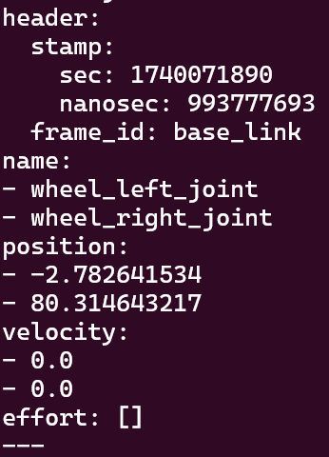
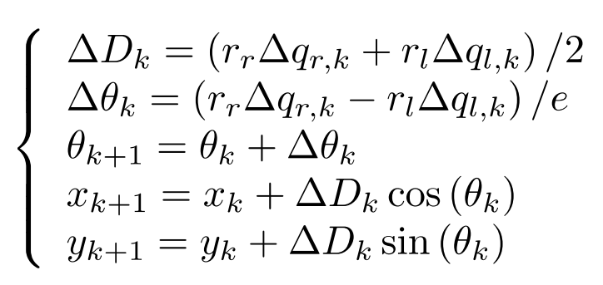
Algorithm: Odometry
Estimate the current pose and velocity using the waffle2/joint_states topic.
Topic data is wheel position in radians.
This can also be accessed using the sensor_states topic.

Slide 5
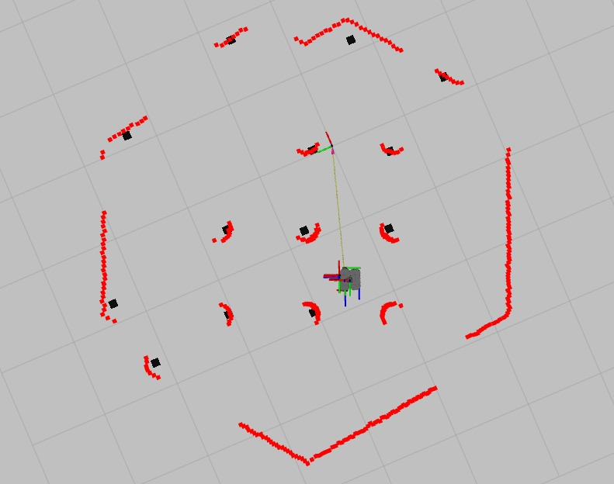
Algorithm: Obstacle Detection
Check if scan value was detected in valid range
Check where it is and assign to a cluster (clusters are formed of points within certain bounds)
Process clusters and create a centroid for each cluster
Assign each centroid to the map as occupied with a shape around it

Slide 6
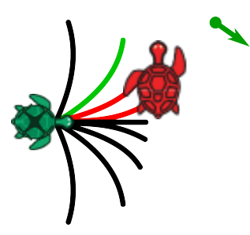
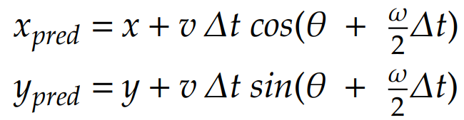
Algorithm: Tentacle method
We use this algorithm to choose the best omega to command
In this algorithm we loop through omega values from -2.0 to 2.0
We check how close the predicted x and y values are to the goal pose

